Slide 1

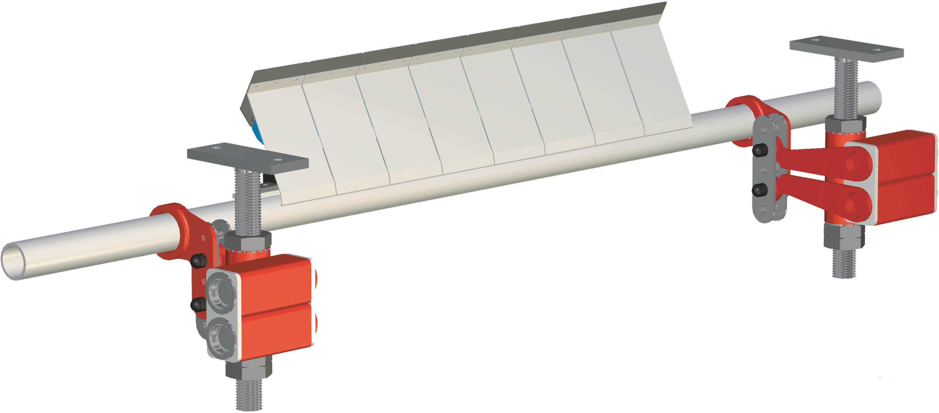
Scraper Type B6 + PEM* - Installation - Title
Installation instructions
* Parallel elasto-mount
Type B6+PEM
©2000 HOSCH
Installation II - 0821T - 20000626 - EN

Slide 2






Scraper Type B6 + PEM* - Determine mounting range
1
3
A *
2
1
Dimensions*
For type B6 with long elements and normal blades |  | A*
 |  | [mm]
B6 - A | (Tube Ø 48mm) | 225
B6 - B | (Tube Ø 60mm) | 230
B6 - C | (Tube Ø 76mm) | 240
B6 - D | (Tube Ø 101mm) | 250
200
3
100
1
min. 350
2
Additional dimensions for special blades / elements | A*
 | [mm]
B6 Z-shaped blade with long element | + 2
B6 V-shaped blade with long element | - 28
B6 Z-shaped blade with short element | - 30
B6 V-shaped blade with short element | - 60
* Parallel elasto-mount
Installation II - 0822T - 20000626 - EN

Slide 3
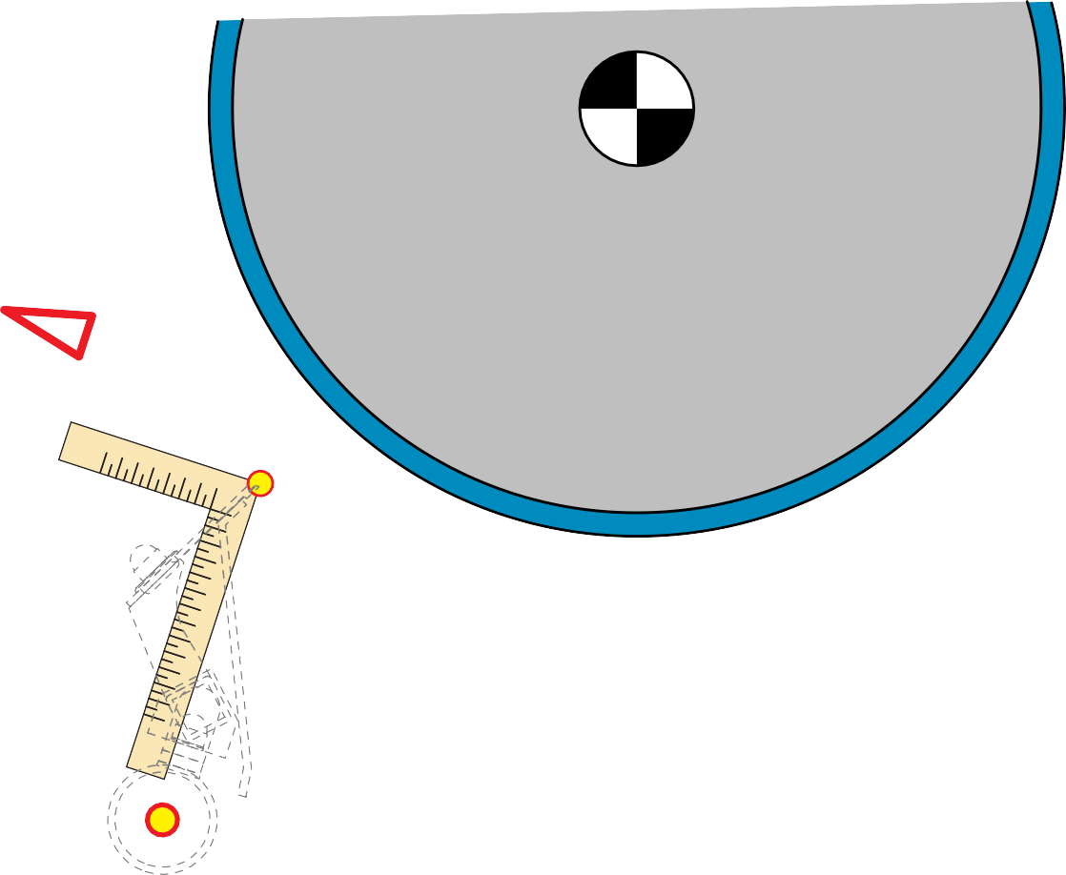









Scraper Type B6 + PEM* - Locate center point of midsection
2
4
Dimensions*
For type B6 with long elements and normal blades |  | B*
 |  | [mm]
B6 - A | (Tube Ø 48mm) | 8
B6 - B | (Tube Ø 60mm) | 8
B6 - C | (Tube Ø 76mm) | 8
B6 - D | (Tube Ø 101mm) | 8
1
5
4
1
Additional dimensions for special blades / elements | B*
 | [mm]
B6 Z-shaped blade with long element | 39
B6 V-shaped blade with long element | 41
B6 Z-shaped blade with short element | 7
B6 V-shaped blade with short element | 11
5
B*
* Parallel elasto-mount
Installation II - 0823T - 20000626 - EN

Slide 4
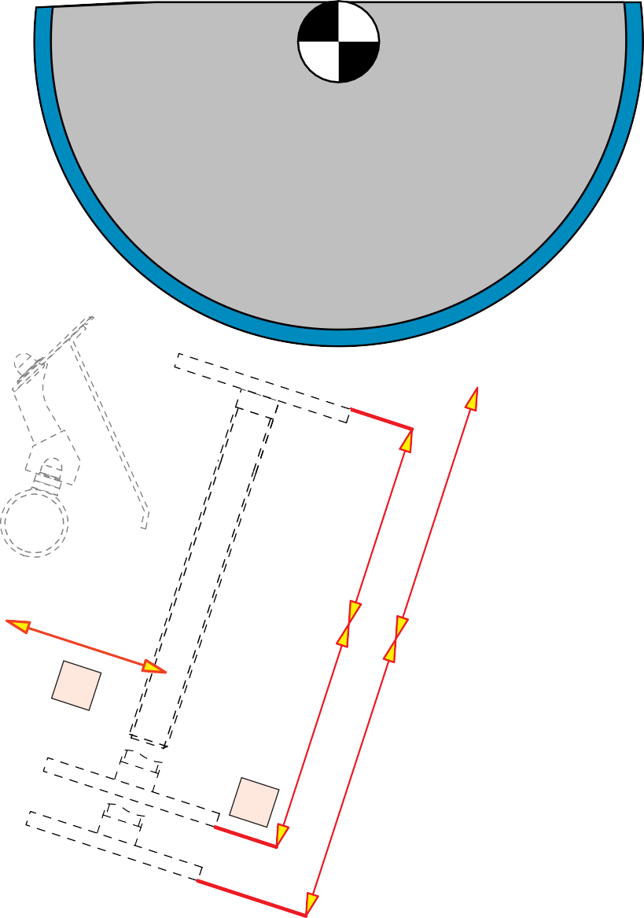






Scraper Type B6 + PEM* - Select spindle position
3
6
5
1
min
*
max
D
*
D
5
C
*
1
min
Dimensions*
For type B6 with long elements and normal blades | C | D | E
 | [mm] | [mm] | [mm]
B6 - A (Tube Ø 48mm) | 210 | 155 - 295 | 75 - 215
B6 - B (Tube Ø 60mm) | 200 | 160 - 370 | 60 - 270
B6 - C (Tube Ø 76mm) | 220 | 160 - 370 | 60 - 270
B6 - D (Tube Ø 101mm) | 240 | 195 - 405 | 80 - 290
*
max
E
*
E
6
* Parallel elasto-mount
©2000 HOSCH
Installation II - 0824T - 20000626 - EN

Slide 5












Scraper Type B6 + PEM* - Provide access for maintenance
4
5
1
F
H
G
1
Dimensions
For type B6 with long elements and normal blades | F | G | H | I
 | [mm] | [mm] | [mm] | [mm]
B6 - A (Tube Ø 48mm) | 230 | 70 | 70 | 100
B6 - B (Tube Ø 60mm) | 230 | 80 | 80 | 100
B6 - C (Tube Ø 76mm) | 240 | 100 | 100 | 100
B6 - D (Tube Ø 101mm) | 250 | 100 | 100 | 100
I
5
* Parallel elasto-mount
Installation II - 0825T - 20000626 - EN

Slide 6
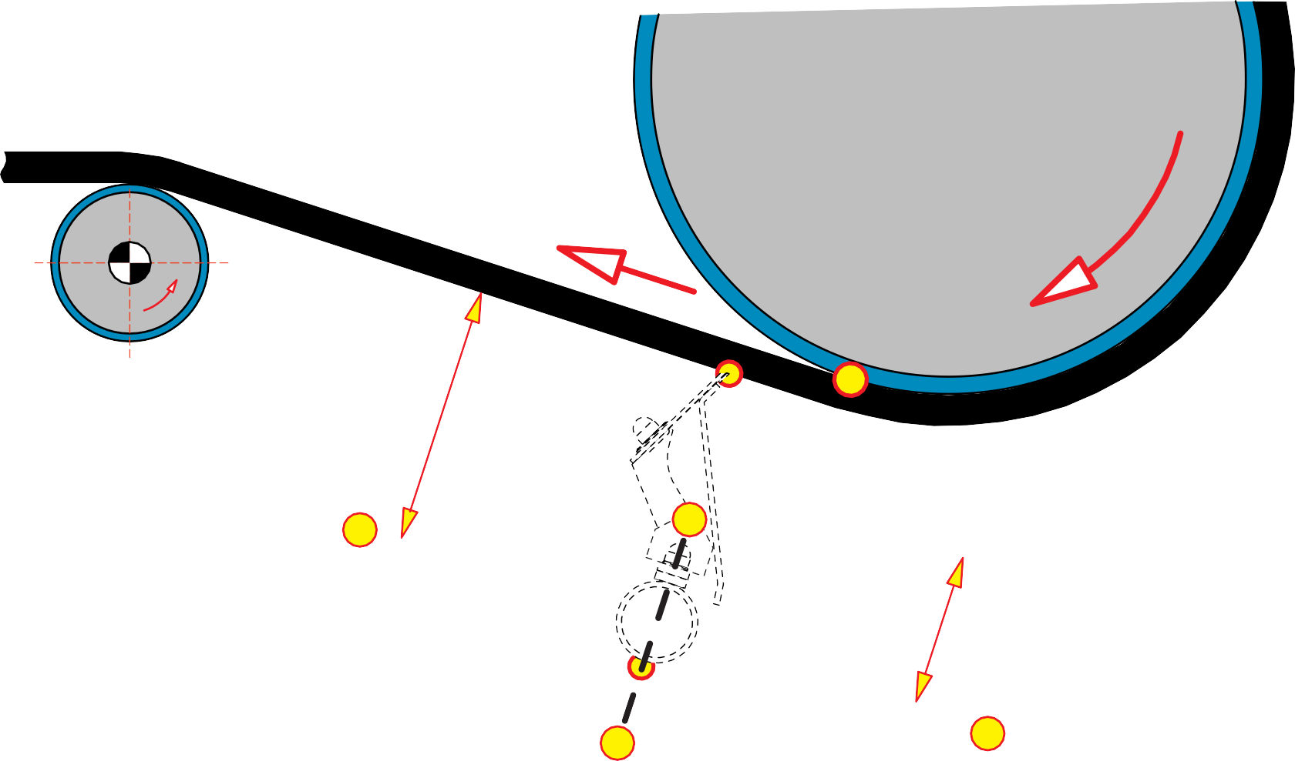
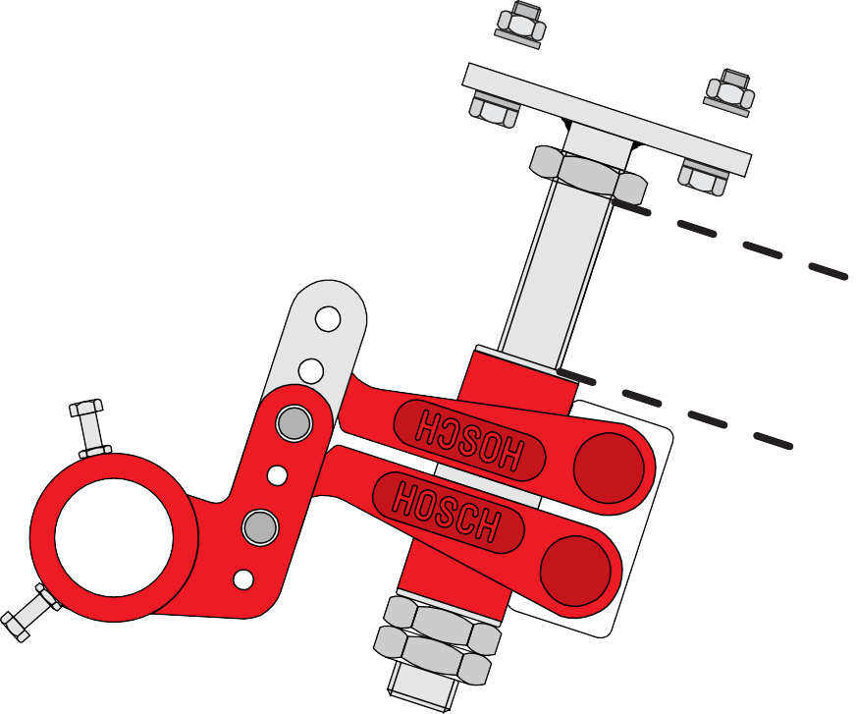


Scraper Type B6 + PEM* - Install spindles and mounts
5
A
*
P
*
1
5
P*
Dimensions*
For type B6 with long elements and normal blades |  | A* | P*
 |  | [mm] | [mm]
B6 - A | (Tube Ø 48mm) | 225 | 100
B6 - B | (Tube Ø 60mm) | 230 | 100
B6 - C | (Tube Ø 76mm) | 240 | 100
B6 - D | (Tube Ø 101mm) | 250 | 100
5
1
* Parallel elasto-mount
Installation II - 0826T - 20000626 - EN

Slide 7
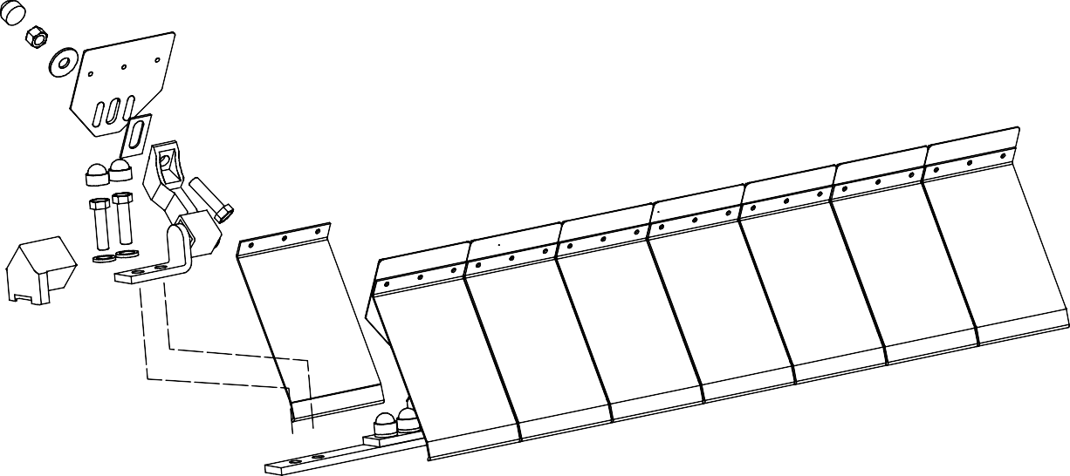
Scraper Type B6 + PEM* - Prepare scraper for installation
6
1
2
* Parallel elasto-mount
Installation II - 0827T - 20000626 - EN

Slide 8







Scraper Type B6 + PEM* - Align assembly carrier
=
2
=
7
1
=
=
4
3
* Parallel elasto-mount
Installation II - 0828T - 20000626 - EN

Slide 9
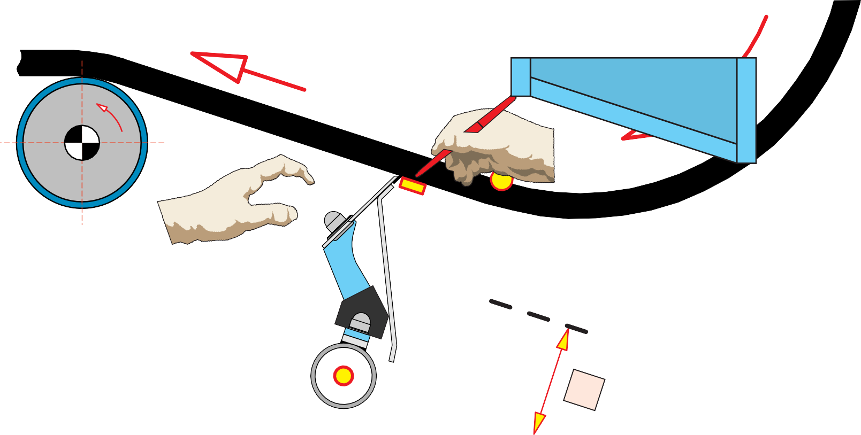
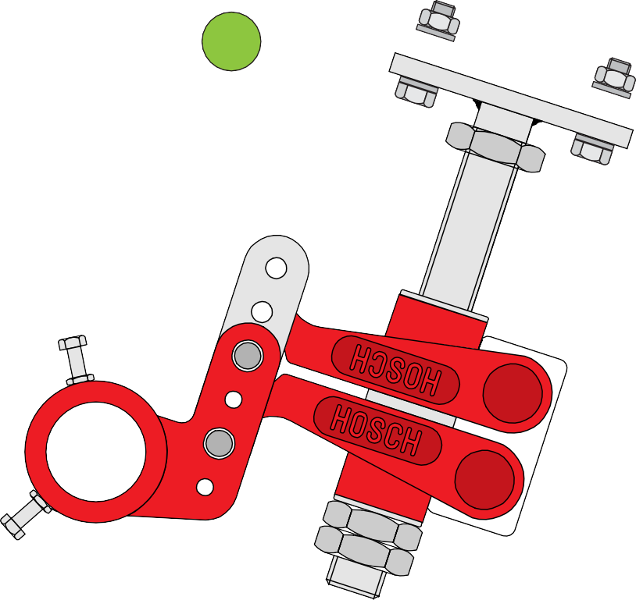





Scraper Type B6 + PEM* -
Tension scraper
8
1
3
Dimensions*
For type B6 with long elements and normal blades |  | Rmin | Smin
 |  | [mm] | [mm]
B6 - A | (Tube Ø 48mm) | 40 | 50
B6 - B | (Tube Ø 60mm) | 40 | 50
B6 - C | (Tube Ø 76mm) | 40 | 50
B6 - D | (Tube Ø 101mm) | 40 | 50
S
R
4
P
*
2
Additional dimensions for special blades / elements | Rmin | Smin
 | [mm] | [mm]
B6 Z-shaped blade with long element | 40 | 70
B6 V-shaped blade with long element | 40 | 70
B6 Z-shaped blade with short element | 30 | 35
B6 V-shaped blade with short element | 25 | 35
* Parallel elasto-mount
Installation II - 0829T - 20000626 - EN

Slide 10

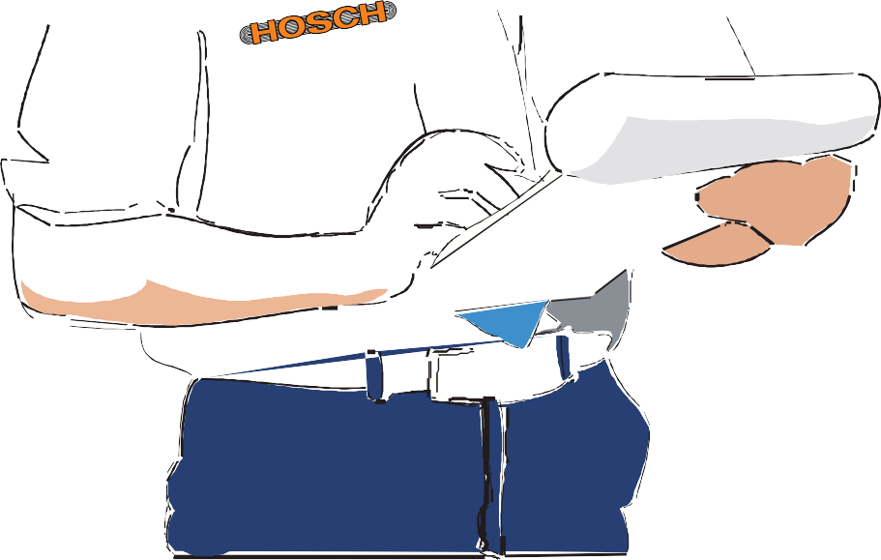

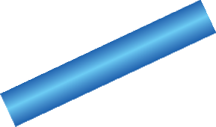

Scraper Type B6 + PEM* - Check installation
9
1
* Parallel elasto-mount
Installation II - 0830T - 20000626 - EN

Slide 11

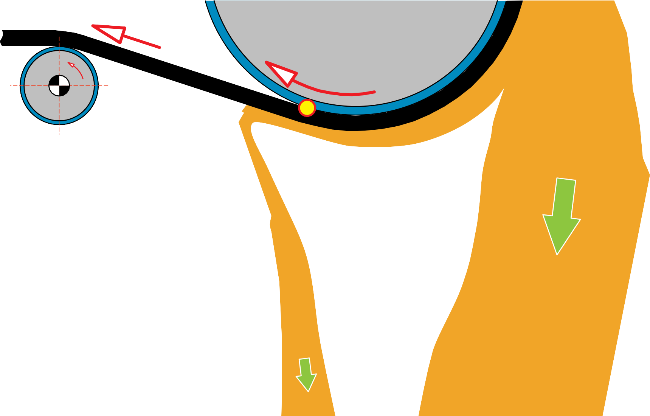
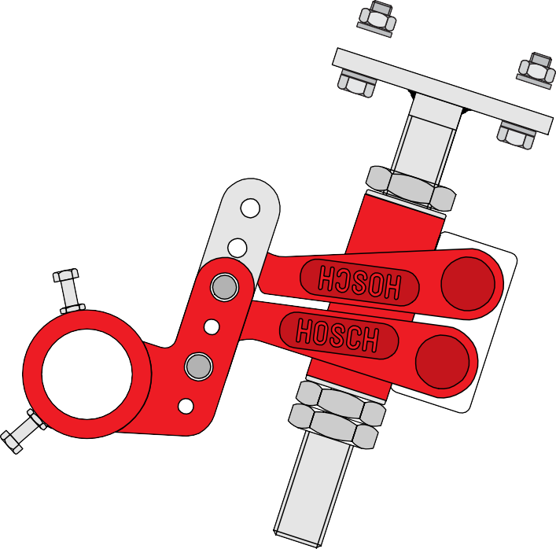




Scraper Type B6 + PEM* -
Perform test run
10
* Parallel elasto-mount
Installation II - 0831T - 20000626 - EN

